Slide 1
Course: Applied Physics (EE 117)
Credit Hours: 3
Instructor: Ali Abbas Khan
Email: ali.abas@nu.edu.pk
Office # 32, Academics Building

Slide 2
Text Book:
Physics for Scientists and Engineers
with Modern Physics (Seventh Edition)
Serway & Jewett
Reference books:
1. University Physics 13th Edition
Hugh D. Young Roger A. Freedman
2. Fundamentals of Physics (Extended),
10th edition, Resnick and Walker

Slide 3
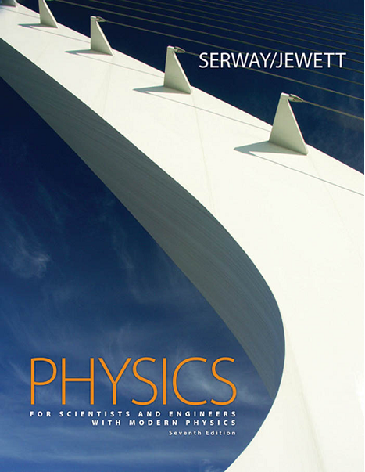
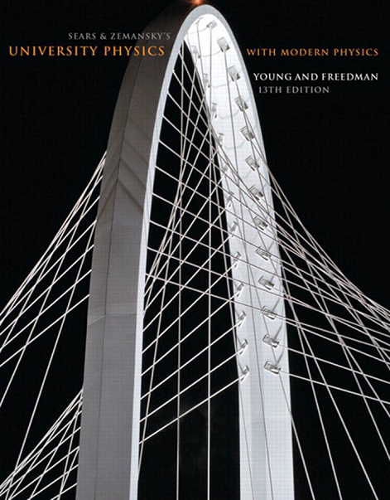

Slide 4
Tentative Assessment Plan
Quiz (5) 10 %
Assignments (5) 10 %
Sessional-I 15%
Sessional-II 15%
Final 50 %
Total 100%

Slide 5
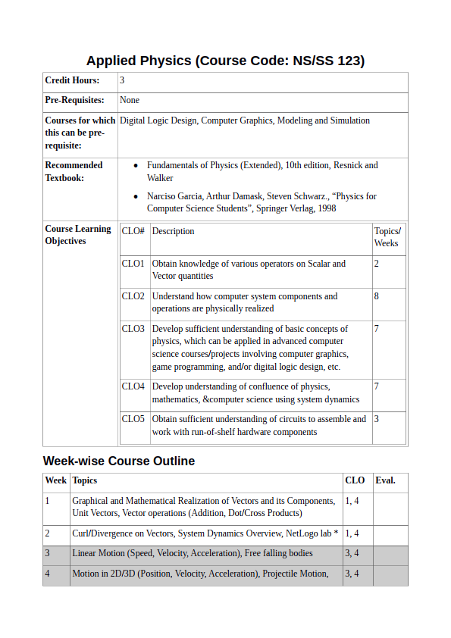
Course Contents

Slide 6
Course Evaluation Policy
There will be no retake of any quiz, assignment, Project/Presentation or any type of Exam.
80% attendance is required for the student to be able to sit in the exam.
Students are advised to come to class in time.
Note: Late comers may be marked as ABSENT

Slide 7
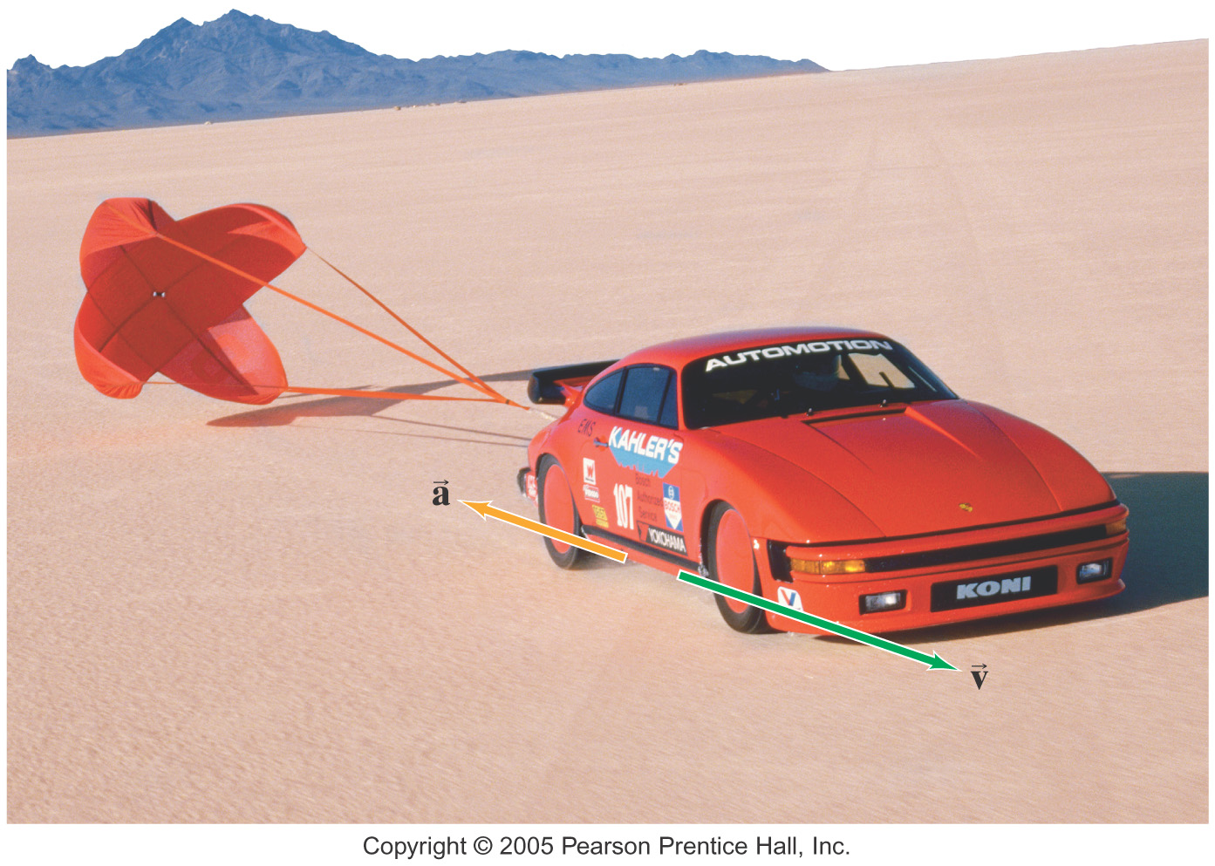
Chapter 2: Motion in One Dimension

Slide 8
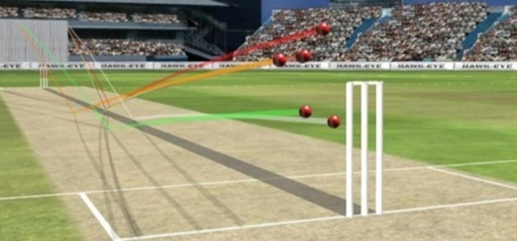
Why study motion?
When a cricket match is telecast live on TV, you are told about many things such as the speed at which the ball was bowled, hitting speed of the batsman, six distance, reaction time of the fielder, trajectories followed by the ball and so on.

Slide 9
Kinematics
To describe motion while ignoring the agents that caused the motion
For now, we will consider motion in one dimension - along a straight line -, and use the particle model.
A particle is a point-like object, has mass but infinitesimal size

Slide 10
Types of Motion
Translational
An example is a car traveling on a highway.
Rotational
An example is the Earth’s spin on its axis.
Vibrational
An example is the back-and-forth movement of a pendulum.

Slide 11
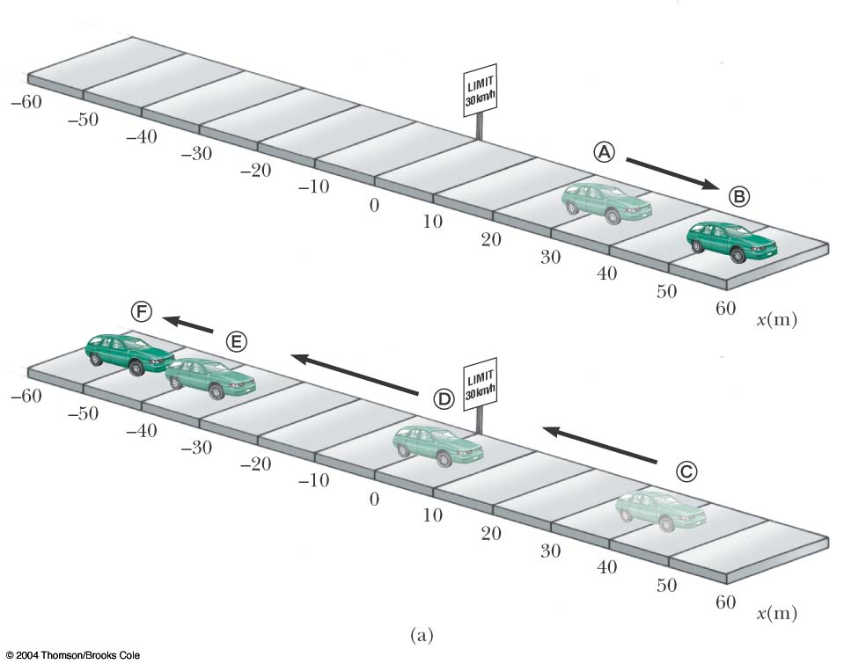
Position
Defined in terms of a frame of reference
The reference frame must has an origin.
The object’s position is its location with respect to the origin of the frame of reference.

Slide 12
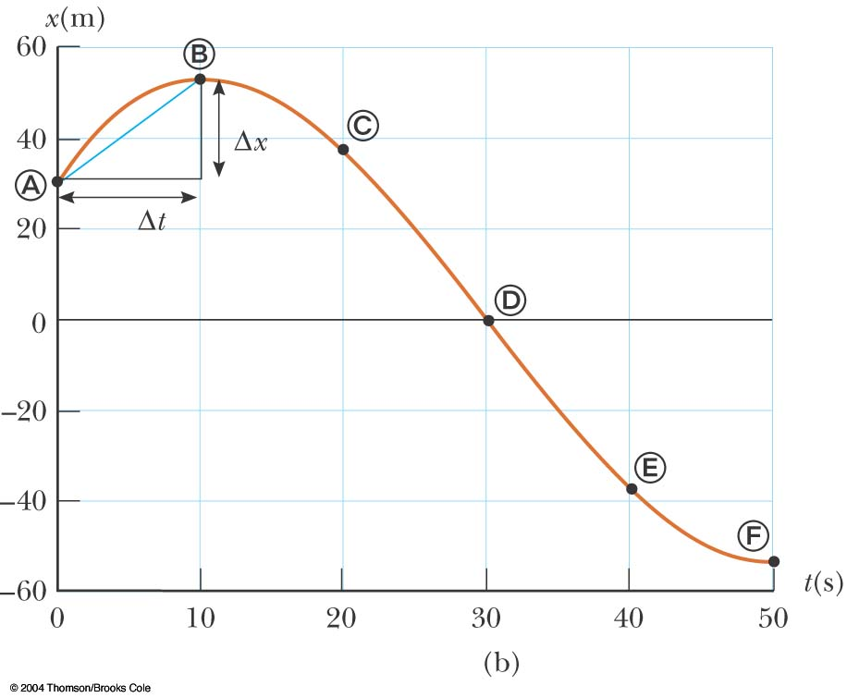
Position-Time Graph
The position-time graph shows the motion of the particle (car)
The smooth curve is a guess as to what happened between the data points

Slide 13
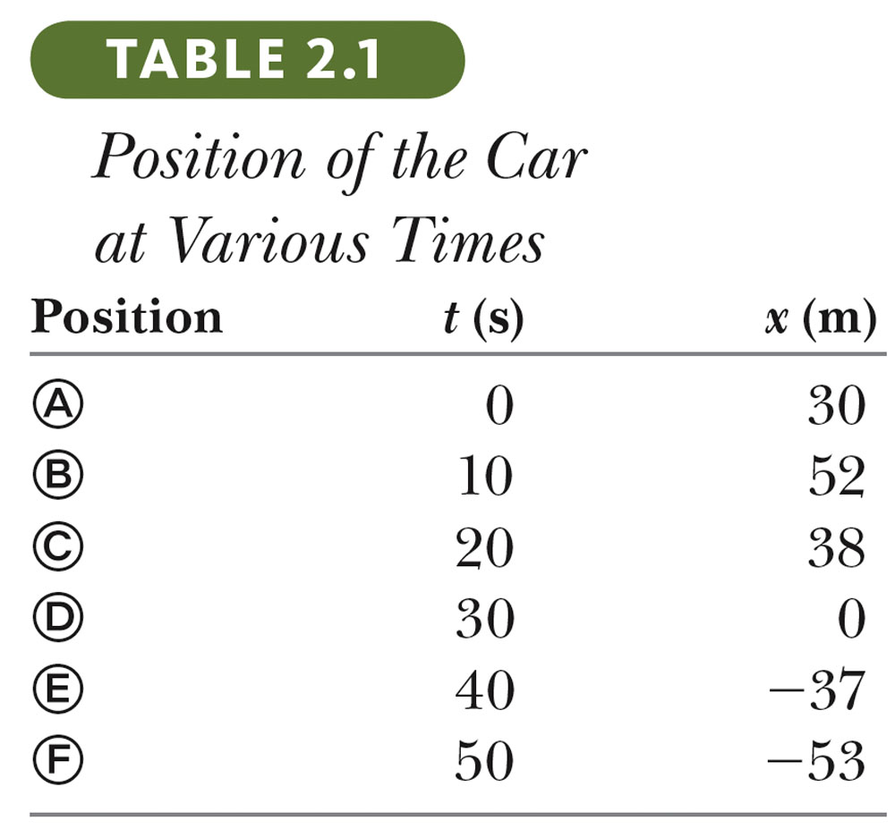
Data Table
The table gives the actual data collected during the motion of the object (car).
Positive is defined as being to the right.

Slide 14
Displacement
Defined as the change in position during some time interval Δt
Represented as Δx
X_{i} is the initial position and X_{f} is the final position.
Different than distance – the length of a path followed by a particle

Slide 15
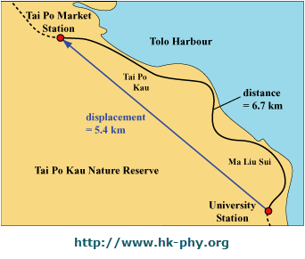
Displacement vs. Distance
Distance is the length of the path that an object travels
Displacement is the change in position of an object

Slide 16
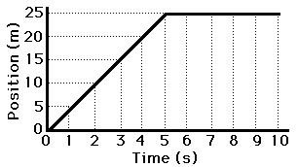
Question
In the position-time graph shown below, what is the position of the moving particle at t=3 seconds and t=5 seconds?

Slide 17
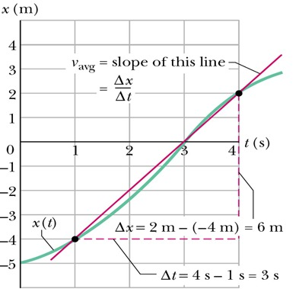
Average Velocity
The average velocity is rate at which the displacement occurs
The slope of the line connecting the initial and final points in the position – time graph

Slide 18
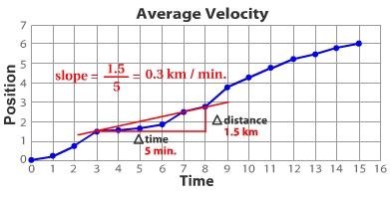
Velocity can be interpreted graphically: Position Time Graphs
Find the average velocity between t = 3 min to t = 8 min

Slide 19
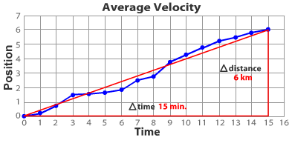
Calculate the average velocity for the entire trip

Slide 20
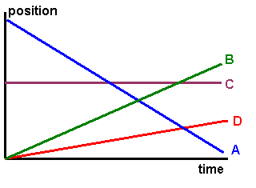
Quick Quiz: Position-Time Graphs
Object at rest?
Traveling slowly in a positive direction?
Traveling in a negative direction?
Traveling quickly in a positive direction?
dev.physicslab.org

Slide 21
Example 2.1 Calculate the Average Velocity

Slide 22
Example 2.1 Calculate the Average Velocity

Slide 23
Example 2.1 Motion of a Jogger

Slide 24
Example 2.1 Motion of a Jogger

Slide 25
Example 2.1 Motion of a Jogger

Slide 26
Instantaneous Velocity
The limit of the average velocity as the time interval becomes infinitesimally short, or as the time interval approaches zero
The instantaneous velocity indicates what is happening at every point of time

Slide 27
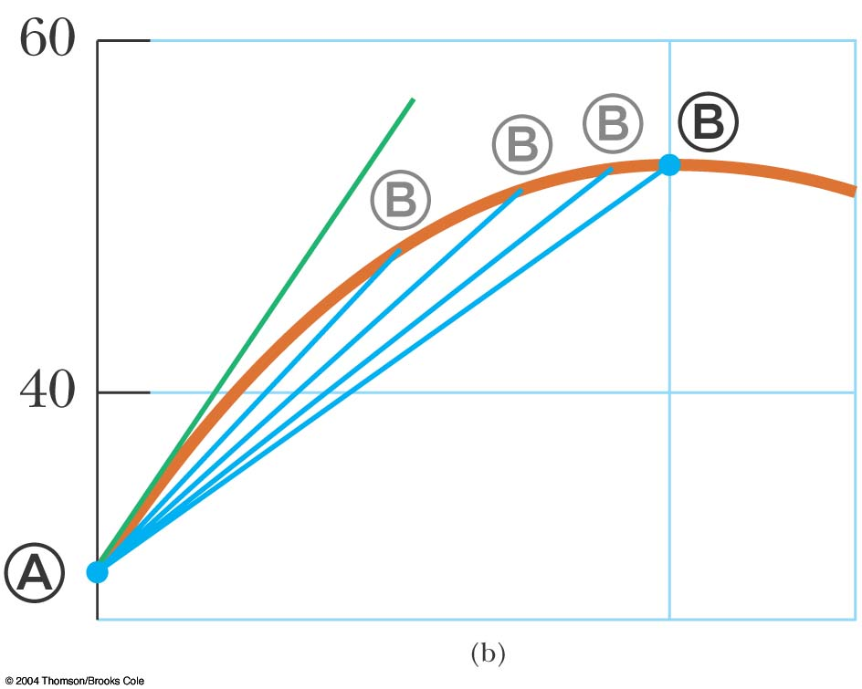
Instantaneous Velocity, Graph
The instantaneous velocity is the slope of the line tangent to the x vs. t curve
This would be the green line
The blue lines show that as Δt gets smaller, they approach the green line

Slide 28
Instantaneous Velocity, equations
The general equation for instantaneous velocity is
When “velocity” is used in the text, it will mean the instantaneous velocity

Slide 29
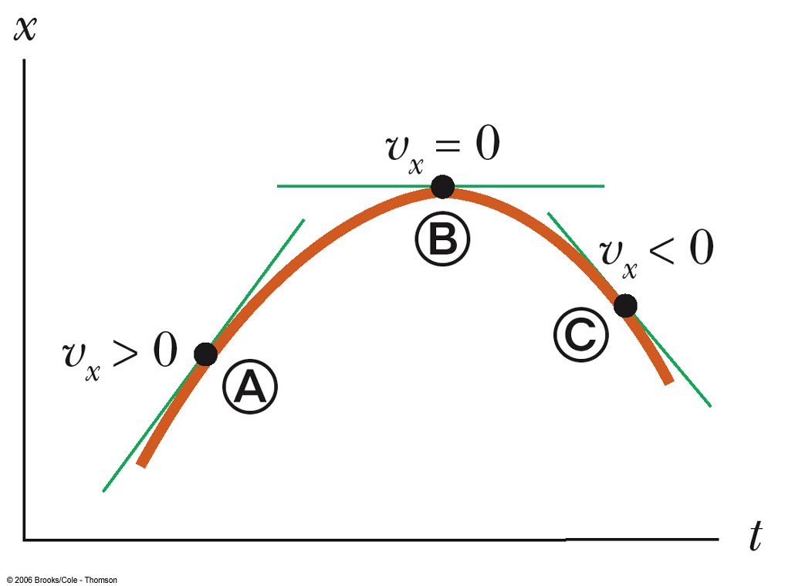
Instantaneous Velocity, Signs
At point A, v_{x} is positive
The slope is positive
At point B, v_{x} is zero
The slope is zero
At point C, v_{x} is negative
The slope is negative

Slide 30
Instantaneous Speed
The instantaneous speed is the magnitude of the instantaneous velocity vector
Speed can never be negative

Slide 31
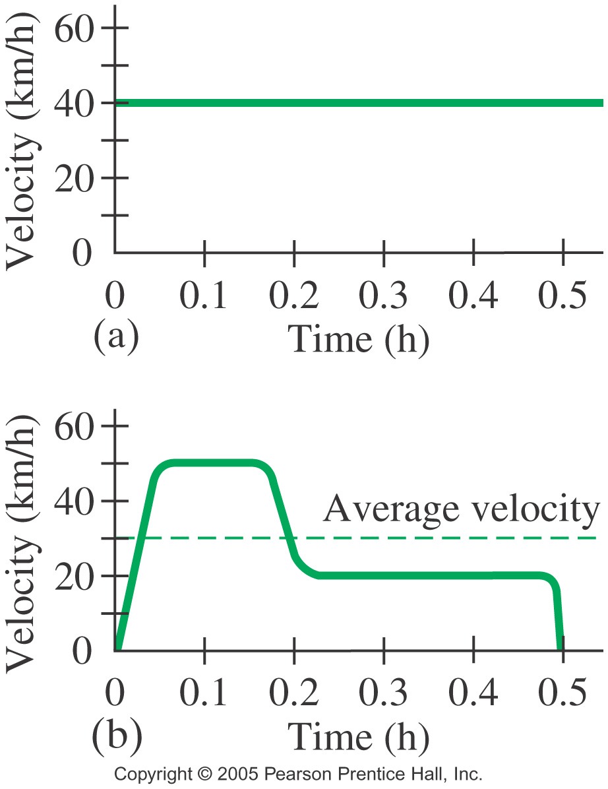
Average vs Instantaneous Velocity
Velocity at any given moment in time or at a specific point in the object’s path

Slide 32
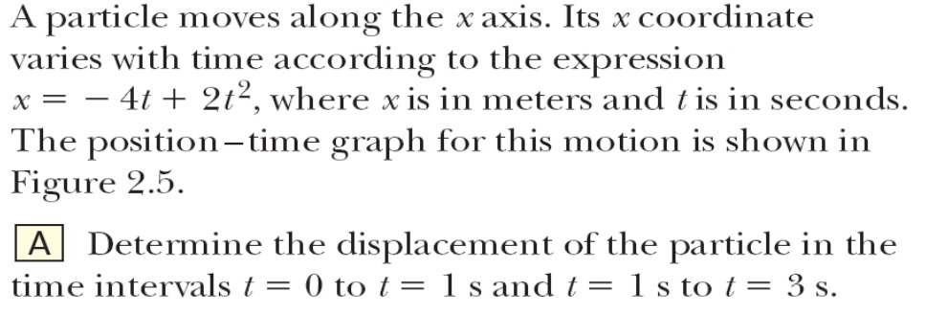
Example 2.3 The Limiting Process

Slide 33
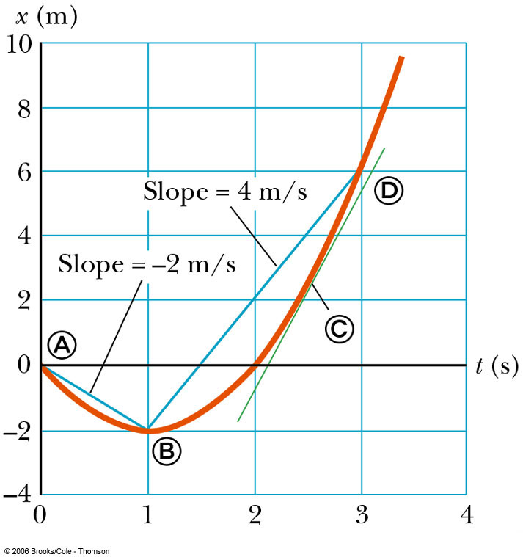
Fig 2.5

Slide 34
Example 2.4 Average and Instantaneous Velocity

Slide 35
Example 2.4 Average and Instantaneous Velocity

Slide 36
Example 2.4 Average and Instantaneous Velocity

Slide 37
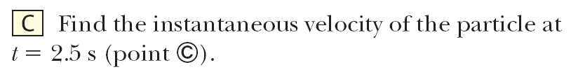
Example 2.4 Average and Instantaneous Velocity

Slide 38
Example 2.4 Average and Instantaneous Velocity

Slide 39
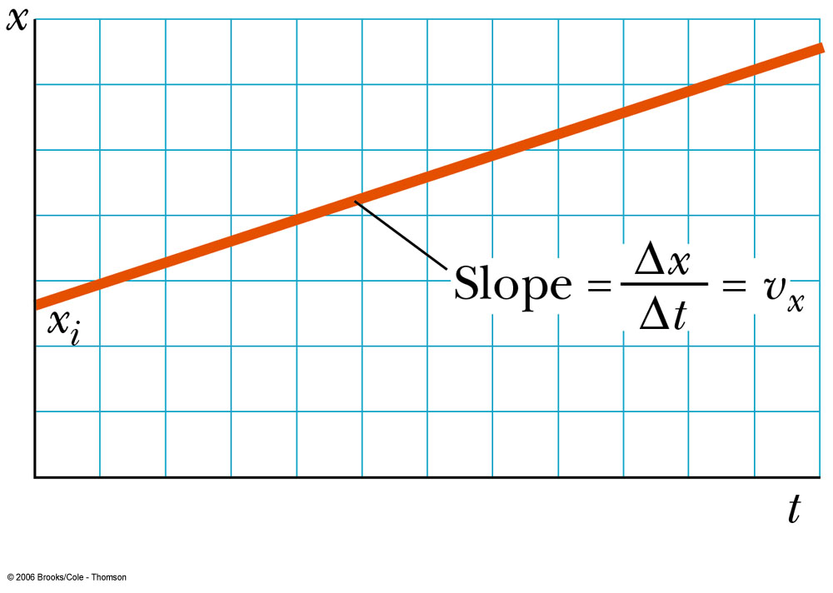
2.3: Constant Velocity
If the velocity of a particle is constant
Its instantaneous velocity at any instant is the same as the average velocity over a given time period
v_{x} = v _{x avg} = Δx / Δt
Also, x_{f} = x_{i} + v_{x} t
These equations can be applied to particles or objects that can be modeled as a particle moving under constant velocity
Fig 2.6

Slide 40
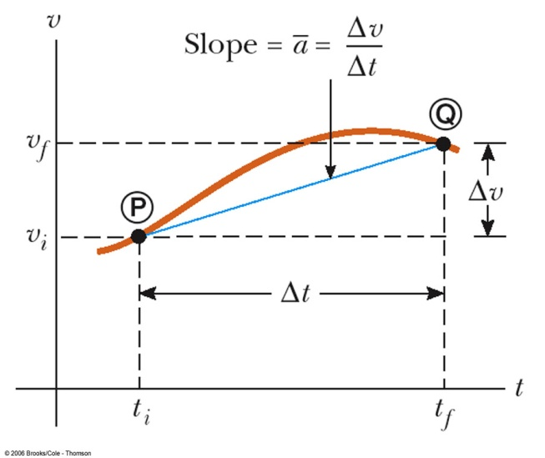
Average Acceleration
Acceleration is the rate of change of the velocity
It is a measure of how rapidly the velocity is changing
SI units are m/s²

Slide 41
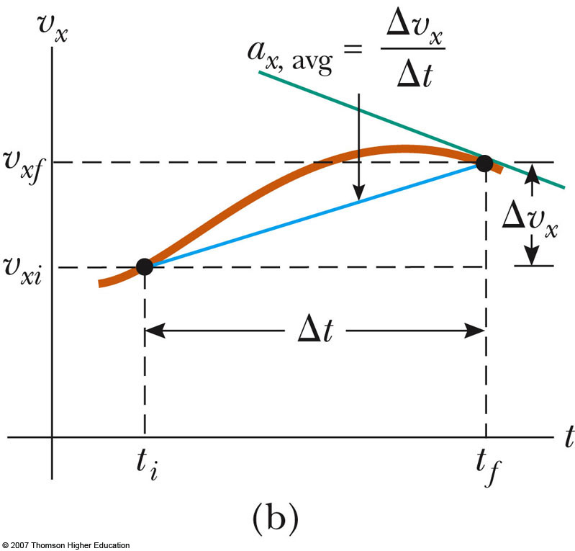
Instantaneous Acceleration
The instantaneous acceleration is the limit of the average acceleration as Δt approaches 0

Slide 42
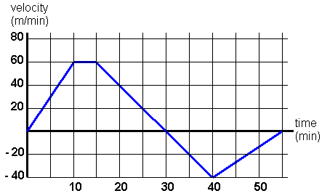
Velocity-Time Graph
dev.physicslab.org

Slide 43
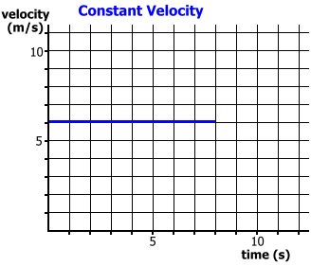
Displacement on v-t Graphs
How can you find displacement on the v-t graph?

Slide 44
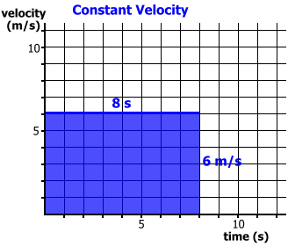
Displacement on v-t Graphs
Displacement is the area under the line!

Slide 45
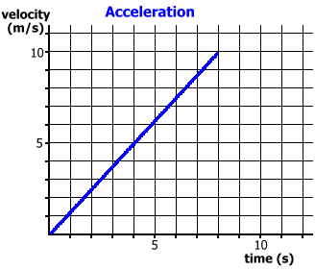
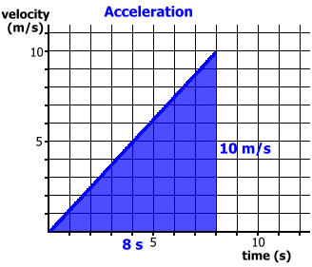
Graphical Representation of Displacement during Constant Acceleration

Slide 46
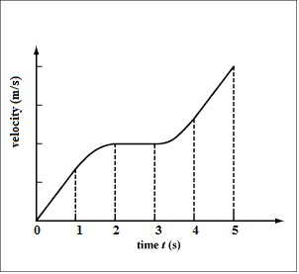
Displacement on a Non-linear v-t graph
If displacement is the area under the v-t graph, how would you determine this area?

Slide 47
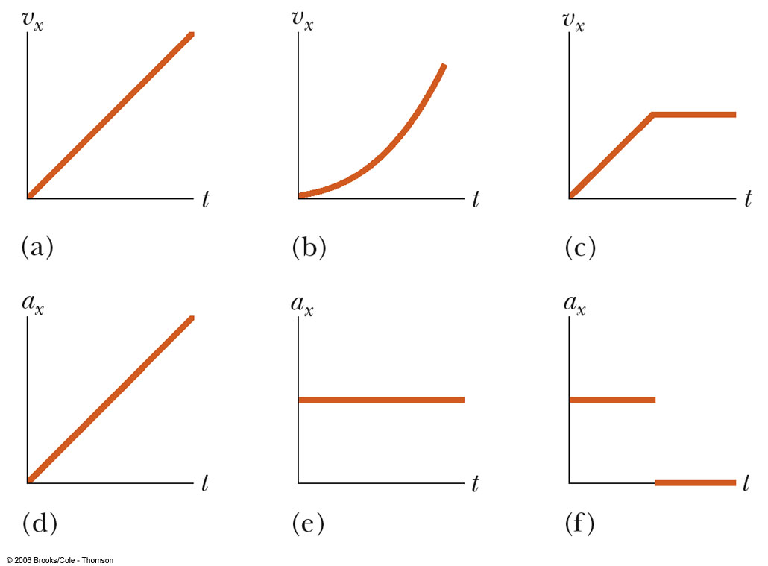
Quick Quiz 2.6
In active Fig 2.12 match each V_{x}-t graph on the top with the a_{x}-t graph on the bottom that best describes the motion.

Slide 48
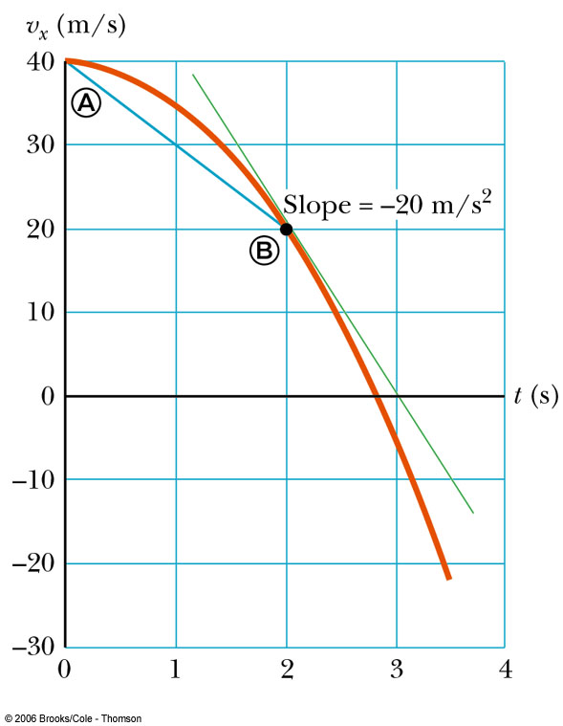
Example 2.6 Average and Instantaneous Acceleration

Slide 49
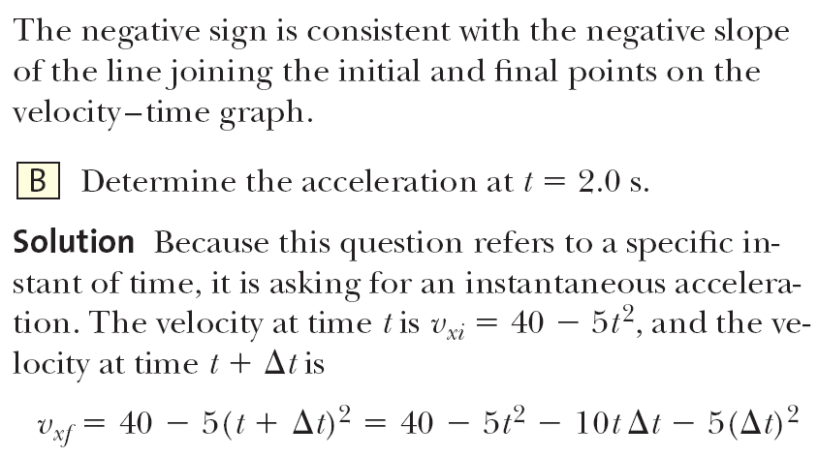
Example 2.6 Average and Instantaneous Acceleration

Slide 50
Example 2.6 Average and Instantaneous Acceleration
V_{x}=40 -5t²

Slide 51
Example 2.6 Average and Instantaneous Acceleration

Slide 52
Negative Acceleration
Negative acceleration does not necessarily mean that an object is slowing down
If the velocity is negative and the acceleration is negative, the object is speeding up
Deceleration is commonly used to indicate an object is slowing down, but will not be used in this text

Slide 53
Acceleration and Velocity, 1
When an object’s velocity and acceleration are in the same direction, the object is speeding up in that direction
When an object’s velocity and acceleration are in the opposite direction, the object is slowing down

Slide 54
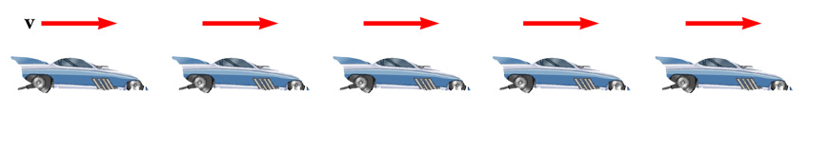
Acceleration and Velocity, 2
The car is moving with constant positive velocity (shown by red arrows maintaining the same size)
Acceleration equals zero

Slide 55
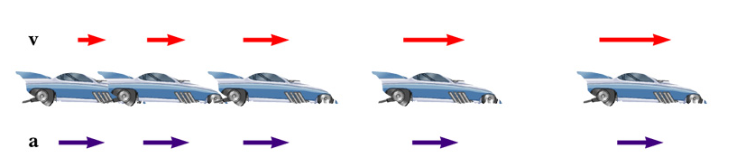
Acceleration and Velocity, 3
Velocity and acceleration are in the same direction
Acceleration is uniform (blue arrows maintain the same length)
Velocity is increasing (red arrows are getting longer)
This shows positive acceleration and positive velocity

Slide 56
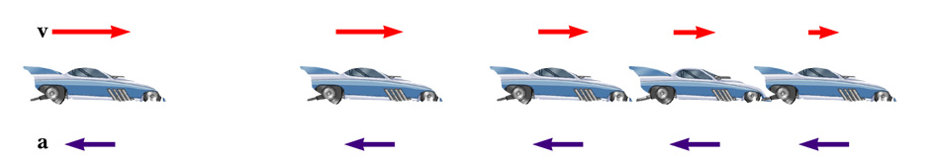
Acceleration and Velocity, 4
Acceleration and velocity are in opposite directions
Acceleration is uniform (blue arrows maintain the same length)
Velocity is decreasing (red arrows are getting shorter)
Positive velocity and negative acceleration

Slide 57
Kinematic Equations
The kinematic equations can be used with any particle under uniform acceleration.
The kinematic equations may be used to solve any problem involving one-dimensional motion with a constant acceleration.
You may need to use two of the equations to solve one problem.

Slide 58
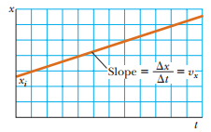
Case of constant Velocity
If the velocity of a particle is constant, its instantaneous velocity at any instant during a time interval is the same as the average velocity over the interval.
Then
For constant Velocity

Slide 59
Problem 2.4
A scientist is studying the biomechanics of the human body. She determines the velocity of an experimental subject while he runs along a straight line at a constant rate. The scientist starts the stopwatch at the moment the runner passes a given point and stops it after the runner has passed another point 20 m away. The time interval indicated on the stopwatch is 4.0 s. (A) What is the runner’s velocity? (B) If the runner continues his motion after the stopwatch is stopped, what is his position after 10 s has passed?

Slide 60
Case of constant acceleration
Kinematic Equations, 1
Average and instantaneous accelerations are the same
Then

Slide 61
Case of constant acceleration
Kinematic Equations, 2
Average and instantaneous accelerations are the same
Conventionally

Slide 62
Case of constant acceleration
Kinematic Equations, 3
Average and instantaneous accelerations are the same

Slide 63
Kinematic Equations, 4
Average and instantaneous accelerations are the same
Case of constant acceleration

Slide 64
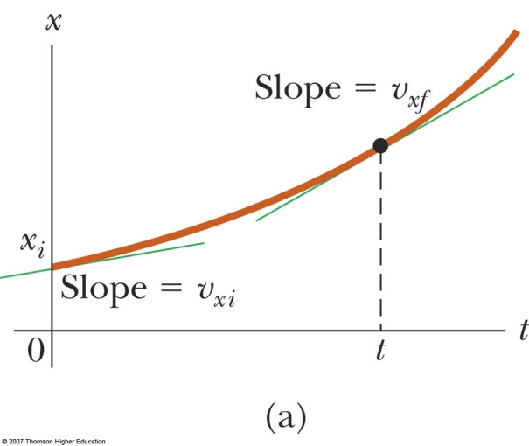
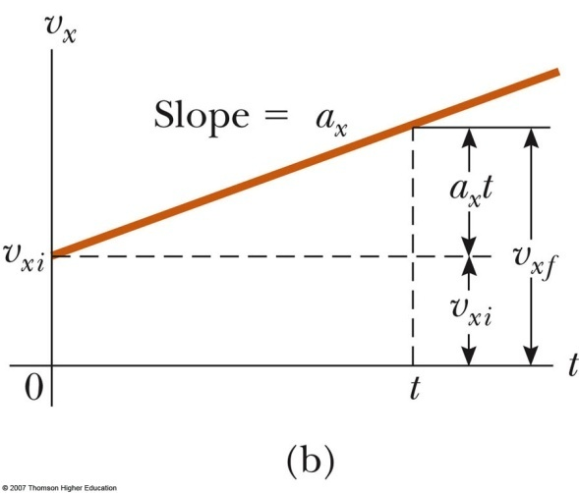
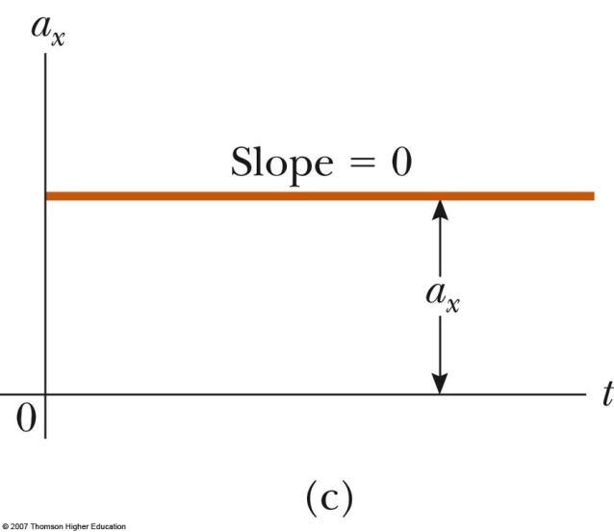
Case of constant acceleration

Slide 65
Case of constant acceleration
To help you solve problems
Equations | Missing variables

Slide 66
Problem 2.7
A jet lands on an aircraft carrier at 140 mi/h (≈ 63 m/s). (A) What is its acceleration (assumed constant) if it stops in 2.0 s due to an arresting cable that snags the jet and brings it to a stop?
(B) If the jet touches down at position x_{i} = 0, what is its final position?
What If? Suppose the jet lands on the deck of the aircraft carrier with a speed higher than 63 m/s but has the same acceleration due to the cable as that calculated in part (A). How will that change the answer to part (B)?

Slide 67
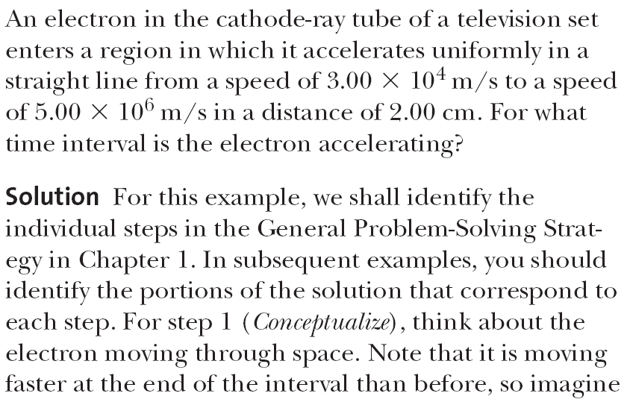
Example 2.7 Accelerating an Electron

Slide 68
Example 2.7 Accelerating an Electron

Slide 69
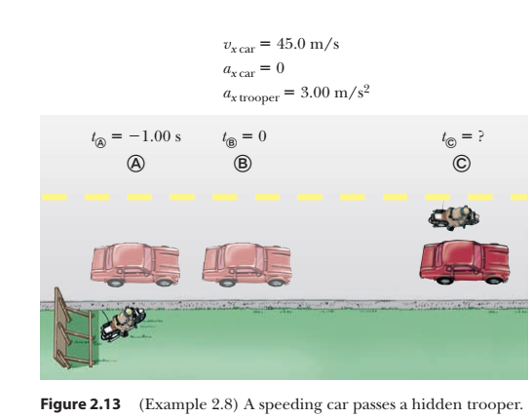
Example 2.8 Watch out for the Speed Limit!
A car traveling at a constant speed of 45.0 m/s passes a trooper on a motorcycle hidden behind a billboard. One second after the speeding car passes the billboard, the trooper sets out from the billboard to catch the car, accelerating at a constant rate of 3.00 m/s². How long does it take her to overtake the car?

Slide 70
Example 2.8 Watch out for the Speed Limit!

Slide 71
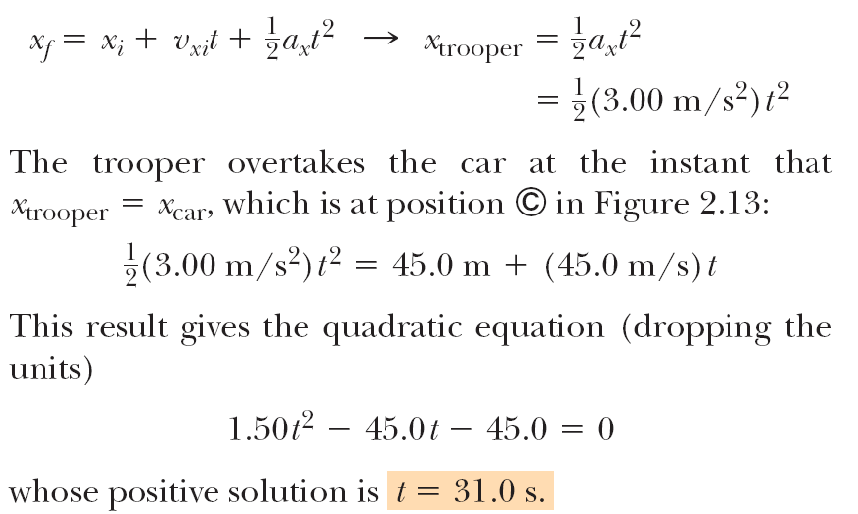
Example 2.8 Watch out for the Speed Limit!

Slide 72
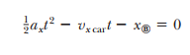
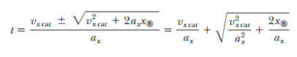
Example 2.8 Watch out for the Speed Limit!
What If? What if the trooper has a more powerful motorcycle with a larger acceleration? How would that change the time at which the trooper catches the car?

Slide 73
2.7 Freely Falling Objects
A freely falling object is any object moving freely under the influence of gravity alone
It does not depend upon the initial motion of the object
Dropped – released from rest
Thrown downward
Thrown upward

Slide 74
Acceleration of Freely Falling Object
Any freely falling object experiences an acceleration directed downward, regardless of its initial motion The magnitude of free fall acceleration is g = 9.80 m/s²
g decreases with increasing altitude
g varies with latitude
9.80 m/s² is the average at the earth’s surface

Slide 75
Acceleration of Free Fall, cont.
We will neglect air resistance
Free fall motion is constantly accelerated motion in one dimension
Let upward be positive
Use the kinematic equations with a_{y} = - g = -9.80 m/s²
The negative sign indicates the direction of the acceleration is downward

Slide 76
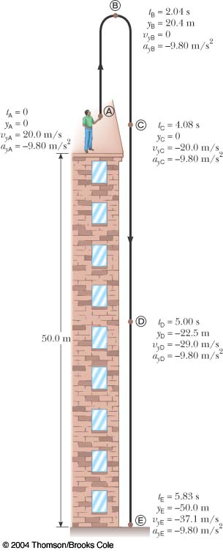
Free Fall Example
Initial velocity at A is upward (+) and acceleration is g (-9.8 m/s²)
At B, the velocity is 0 and the acceleration is g (-9.8 m/s²)
At C, the velocity has the same magnitude as at A, but is in the opposite direction
The displacement is –50.0 m (it ends up 50.0 m below its starting point)

Slide 77
Example 2.10 Not a Bad Throw for a Rookie!

Slide 78
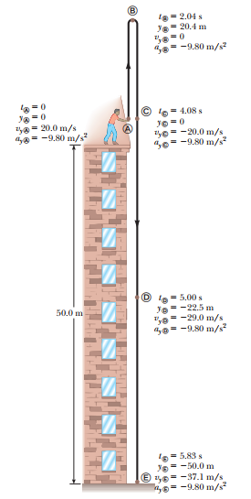

Slide 79
Example 2.10 Not a Ba Throw for a Rookie!

Slide 80
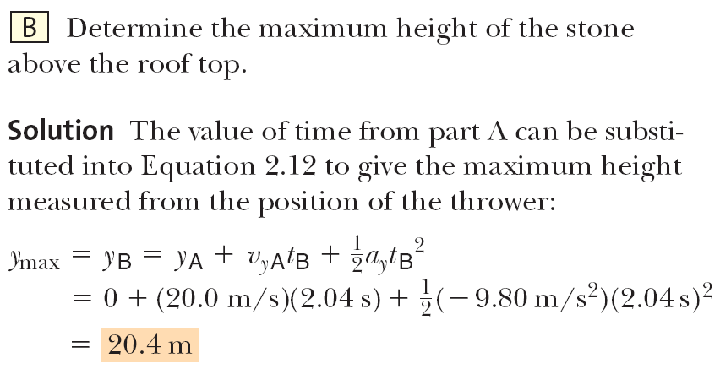
Example 2.10 Not a Ba Throw for a Rookie!

Slide 81
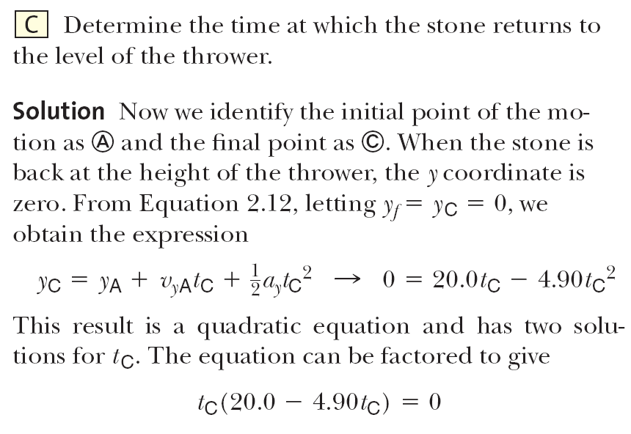
Example 2.10 Not a Ba Throw for a Rookie!

Slide 82
Example 2.10 Not a Ba Throw for a Rookie!

Slide 83
Example 2.10 Not a Ba Throw for a Rookie!

Slide 84
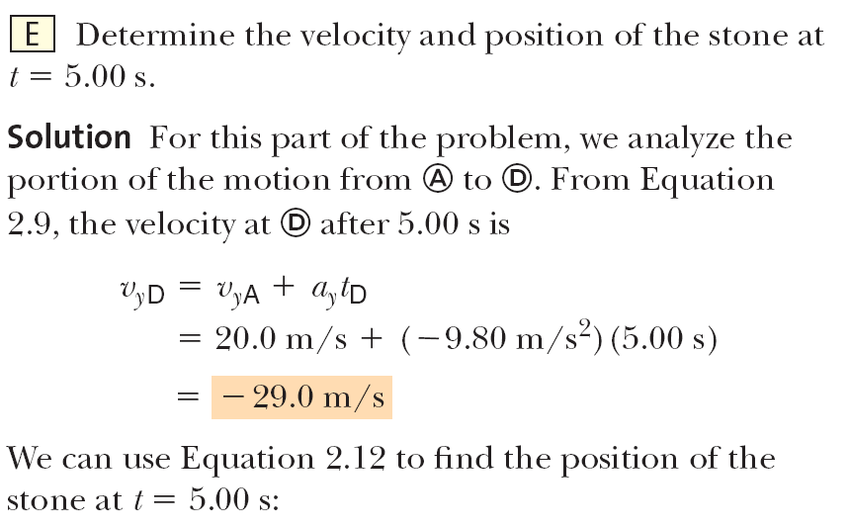
Example 2.10 Not a Ba Throw for a Rookie!

Slide 85
Example 2.10 Not a Ba Throw for a Rookie!

Slide 86
Example 2.10 Not a Ba Throw for a Rookie!

Slide 87
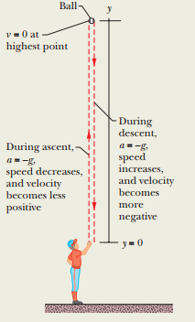

Sample Problem 2.05 (Fundamental Physics)
In Fig. 2-13, a pitcher tosses a baseball up along a y axis, with an initial speed of 12 m/s. (a) How long does the ball take to reach its maximum height?

Slide 88


Slide 89



Slide 90
Assignment#01 Exercises of Chapter 2
4,5, 8, 13, 14, 24, 28, 32, 33, 41, 44, 55, 60, 63

